Slide 1



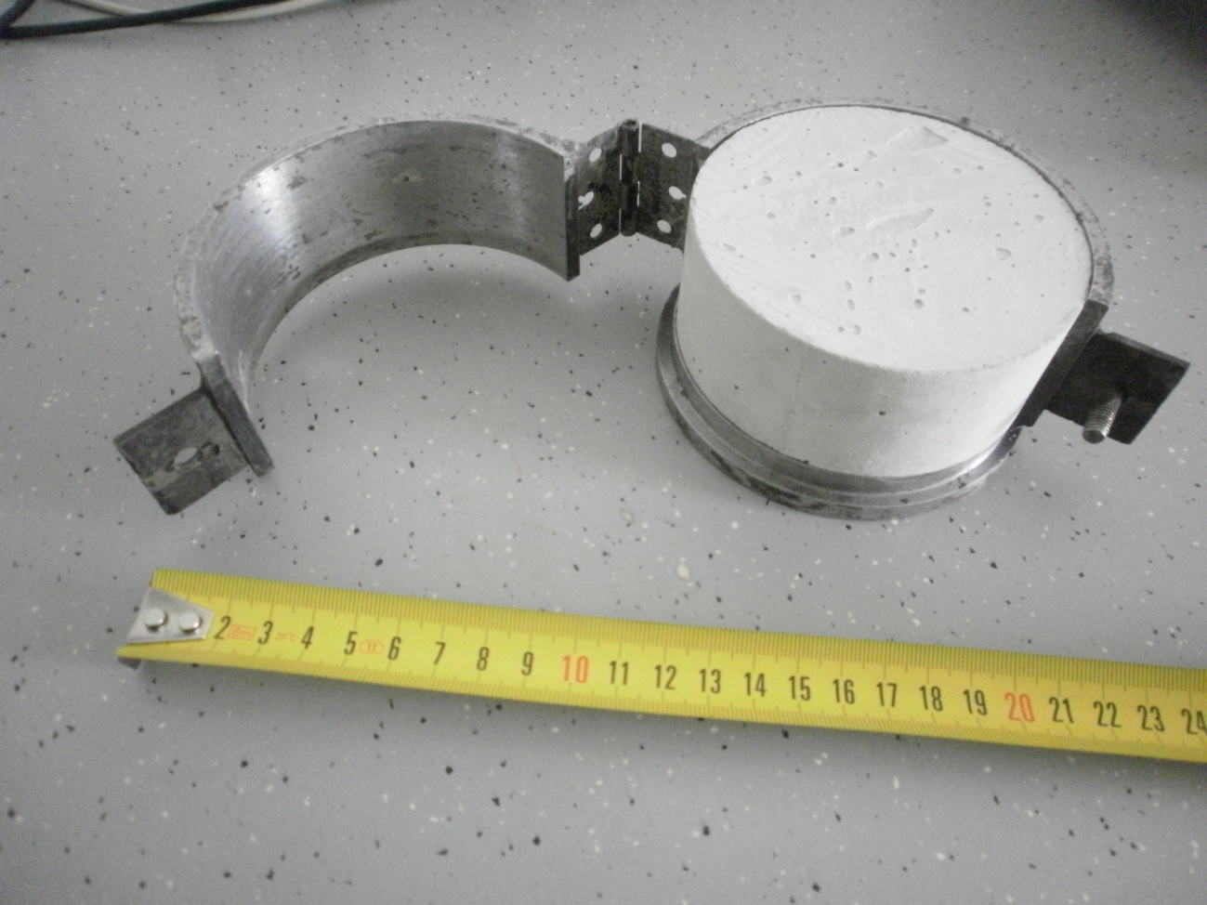
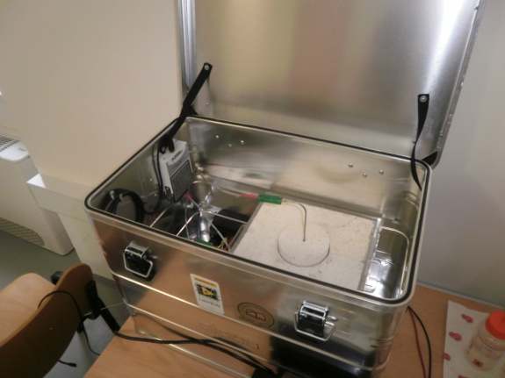
Development of a high thermally conductive concrete
Miro Zdovcª, Matjaž Valant^{a,b}, Andraž Ceket^{c}, Matej Kosovel^{c}
ª Center of Excellence for Biosensors, Instrumentation and Process Control
^{b} Materials Research Laboratory, University of Nova Gorica
^{c} Corus inženirji, d.o.o.
Introduction
We approached to the improvement of geothermal probe system by development of a concrete composition with high thermal conductivity. The quantities of the cement and the aggregate were selectively replaced by high conductive materials keeping the same distribution of grain size.
Measurement
For measuring the thermal conductivity of the concrete a laboratory device was developed (fig. 2) based on modified transient plane source method. Since concrete can be treated as low thermal conductivity material in general, the modifications of standard measuring method were made in order to detect smaller quantities of the heat.
Further improvement will be made since the porosity was appearing as side effect (fig. 4) with samples containing SiC. The expected trend (red line in fig. 4) was not acchieved due to afore mentioned porosity. Second part of measurements included replacing the half of cement with graphite ( yellow dot in fig. 5). Finally we added to improved cement paste SiC ( orange dot in fig. 5). Thermal conductivity with that composition was three times higher that that of basic concrete mixture.
Sample preparation
The cylinder shape samples were 40 mm heigh with diameter 98 mm. Three samples were made for each series. For concrete preparation optimized ratio according literature was used: s/c= 2,13, w/c = 0,55. After 24 h under air and cover with a foil the samples were demolded and cured in a water at room temperature for 28 days.
ΔT (%)
time (s)
cp 0 20 40 60 80 100
SiC (%)
Fig.3: Measured curves of temperature differences for calculation of thermal conductivity
– relative scale among samples with different additions of SiC as sand replacement material
Fig.4: Replacement of the sand with SiC leaded to increased thermal conductivity. Because of different mechanism of hydratation processes the porosity appeared
Results
The increasing of thermal conductivity was acchieved by adding high thermal conductivity materials either as sand replacing (SiC) or cement replacing (graphite). Cumulative contribution to ellevated thermal conductivity was acchieved by introduction of both new materials (last measurement in fig. 3) .
Fig.1: Casted concrete sample in a steel model
Fig.5: Replacing 50 % of cement with graphite in cement paste increased thermal conductivity (yellow dot). Adding SiC to improved cement paste (orange dot) resulted in achieving the result that is good foundation to final optimizing
Fig.2: Device for measuring the thermal conductivity

